Slide 1
Step Into Java:
Collages! (not 2 b confused
w/ Colleges)
Mr. Neat
Java

Slide 2
Collages
Copy one Pix to another…
flower
joe
Picture joe = new Picture(…
Picture flower = new Picture(…

Slide 3
Collages
Copy one Pix to another…
flower
joe
Picture joe = new Picture(…
Picture flower = new Picture(…
joe.copy(flower,100,0);

Slide 4
To Picture
From Picture
flower
joe
joe.copy(flower,100,100);

Slide 5
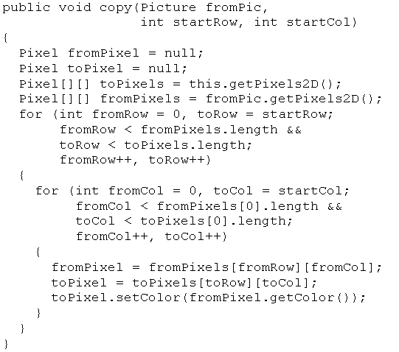
Collages
Let’s explore the copy method (from the Picture
class)

Slide 6
To Picture
From Picture
fromPixel
toPixel
fromRow,
fromCol
toRow,
toCol
fromPixel = fromPixels[fromRow][fromCol];
toPixel = toPixels[toRow][toCol];
toPixel.setColor(fromPixel.getColor());

Slide 7
Collages
Let’s explore the copy method (from the Picture
class)
makes sure copied pix
doesn’t go off page

Slide 8

To Picture
From Picture
fromRow,
fromCol
toRow,
toCol

Slide 9
Collages
Copy one Pix to another…

Slide 10

Collages Go Crazy!

Slide 11
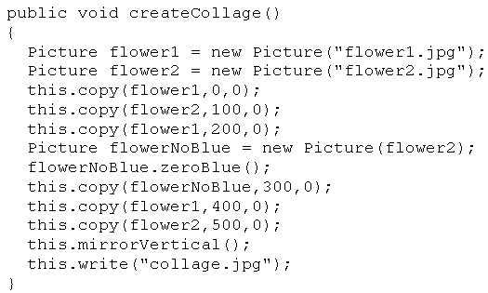
Collages Go Crazy!

Slide 12

Lab – Collage

